Slide 1
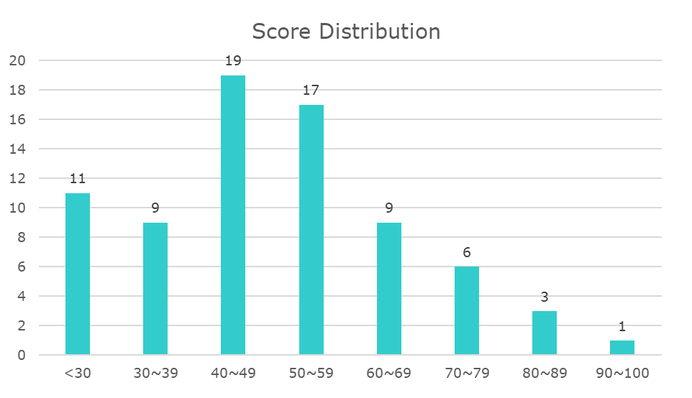
Fall 2019 CS350 midterm feedback
Average = 49

Slide 2
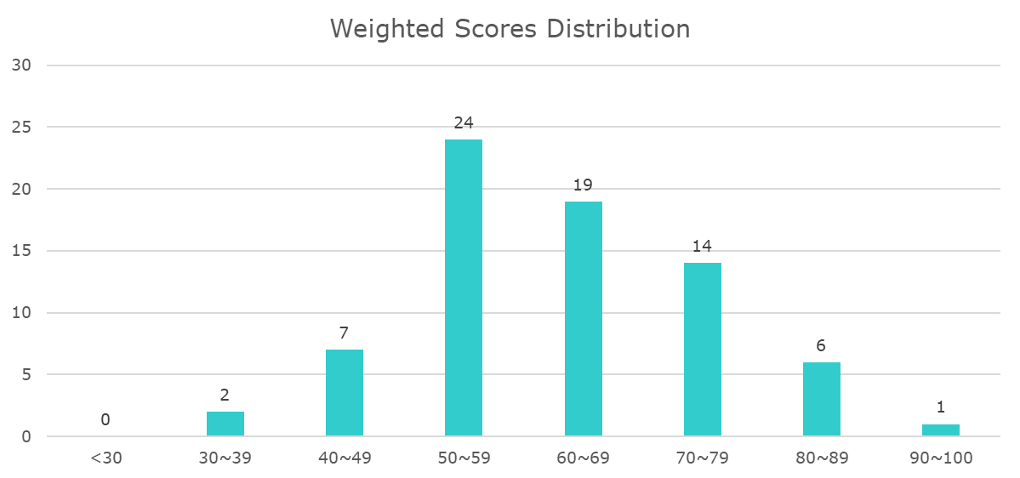
Combined
Average = 63
Midterm 60%
Homework and Labs 35%
Quiz 5%

Slide 3
Modified Midterm Grade Calculation
MG: Mid term grade used to calculate your final course grade
M: score in the mid term exam
F: score in the final exam
The following formula says that a better final improves your mid term grade
MG = (M + (F – M)Δ)
Δ = 0.5 (subject to change) for F > m
= 0 for F ≤ m.

